Slide 1
AI Conferencing
20xx ━ website.com
Professional Business Presentation | MERN Stack | WebRTC | AI Augmentation

Slide 2

Introduction
This presentation outlines a peer-to-peer video conferencing platform leveraging the MERN stack and WebRTC, enhanced with advanced AI features to boost productivity and collaboration.

Slide 3
01
Platform Features

Slide 4
Secure peer-to-peer video and audio conferencing
The platform provides end-to-end encrypted video, audio, and data streaming using WebRTC, ensuring privacy and real-time communications.

Slide 5
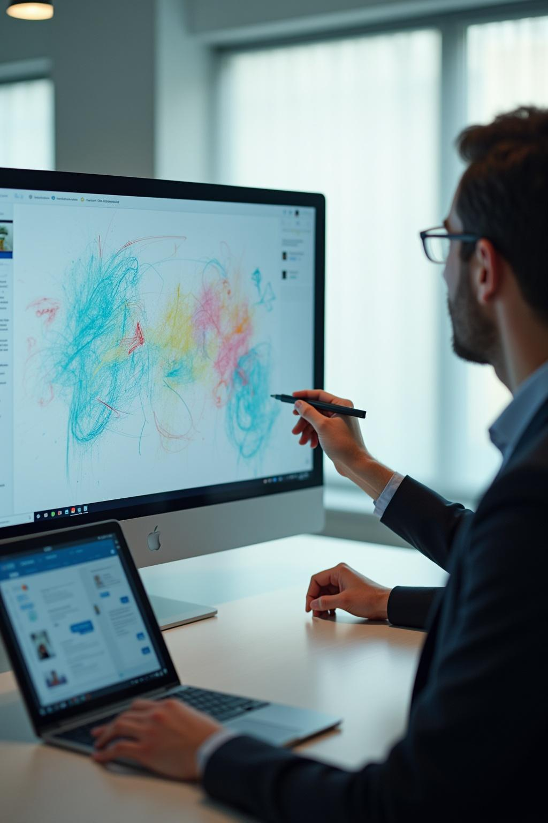
Real-time collaboration tools: whiteboard and chat
Users can engage with a synchronized whiteboard and integrated group or private chat for dynamic interaction during meetings.

Slide 6
AI-powered transcription, translation, and summaries
The platform integrates AI-powered live transcription, multilingual translation, and automated meeting summaries using advanced NLP and LLMs to enhance accessibility and productivity.

Slide 7
02
Architecture & Implementation

Slide 8
MERN stack and WebRTC integration
Built on the MERN stack (MongoDB, Express.js, React.js, Node.js) combined with WebRTC, the platform supports secure real-time media and data exchange.

Slide 9
Scalable, low-latency, and secure backend design
The backend is designed for scalability and low latency, incorporating end-to-end encryption, JWT/OAuth authentication, and robust auto-reconnect features for reliability.

Slide 10
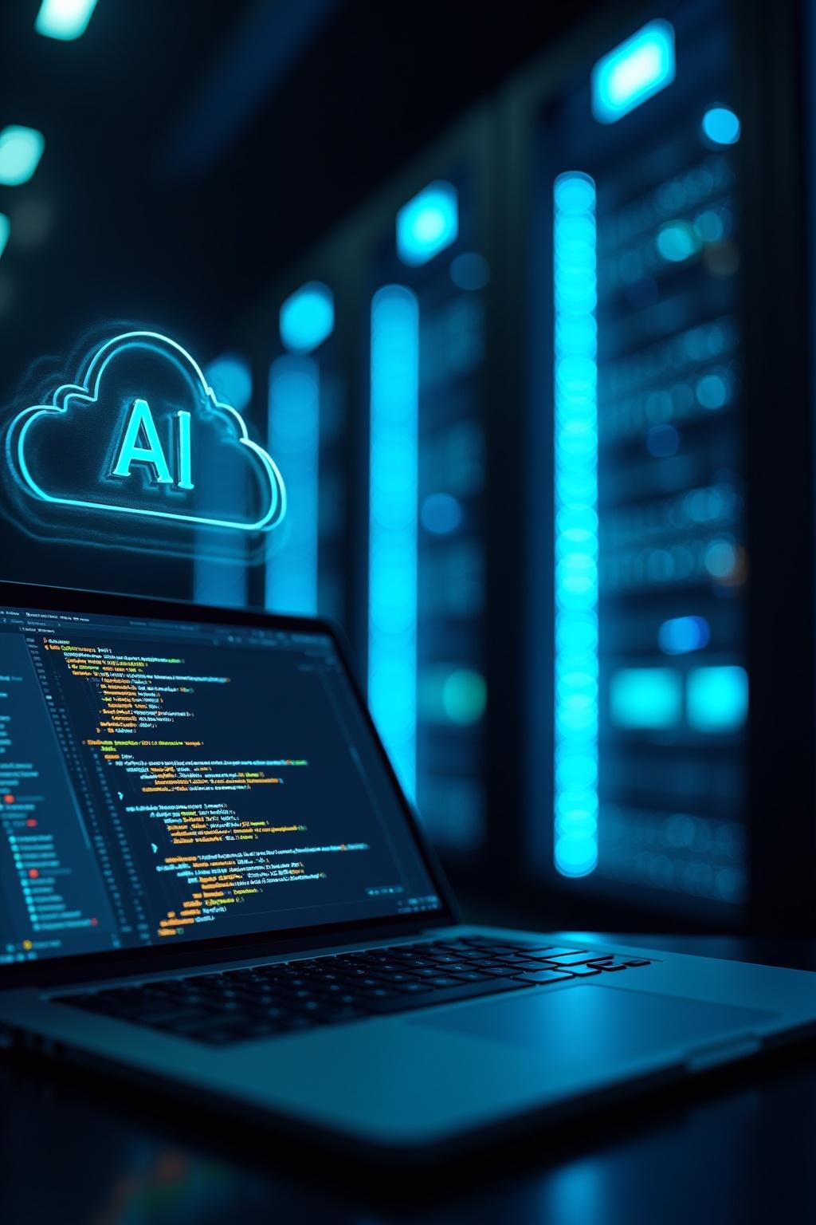
AI services integration and deployment strategy
AI functions leverage Whisper AI for speech-to-text and GPT for summarization, deployed on cloud platforms like AWS and MongoDB Atlas for seamless scalability.

Slide 11
Conclusions
This platform offers a secure, scalable, and AI-enhanced conferencing solution, improving collaboration, communication, and productivity across diverse professional settings.

Slide 12
THANK YOU
Do you have any questions?
youremail@freepik.com
+00 000 000 000
yourwebsite.com
Please keep this slide for attribution

